Slide 1













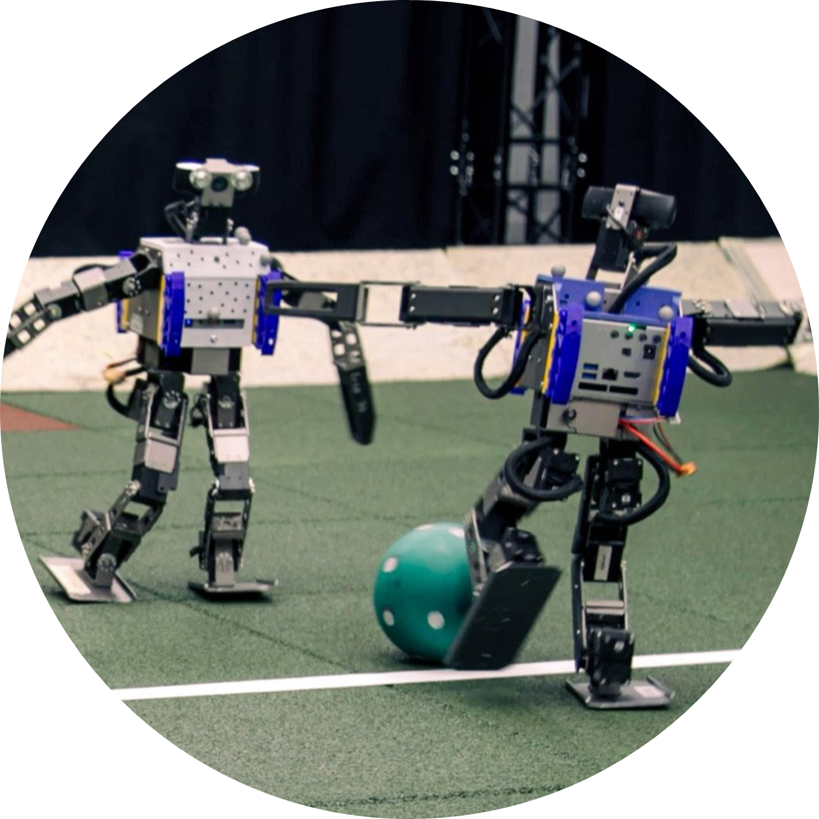





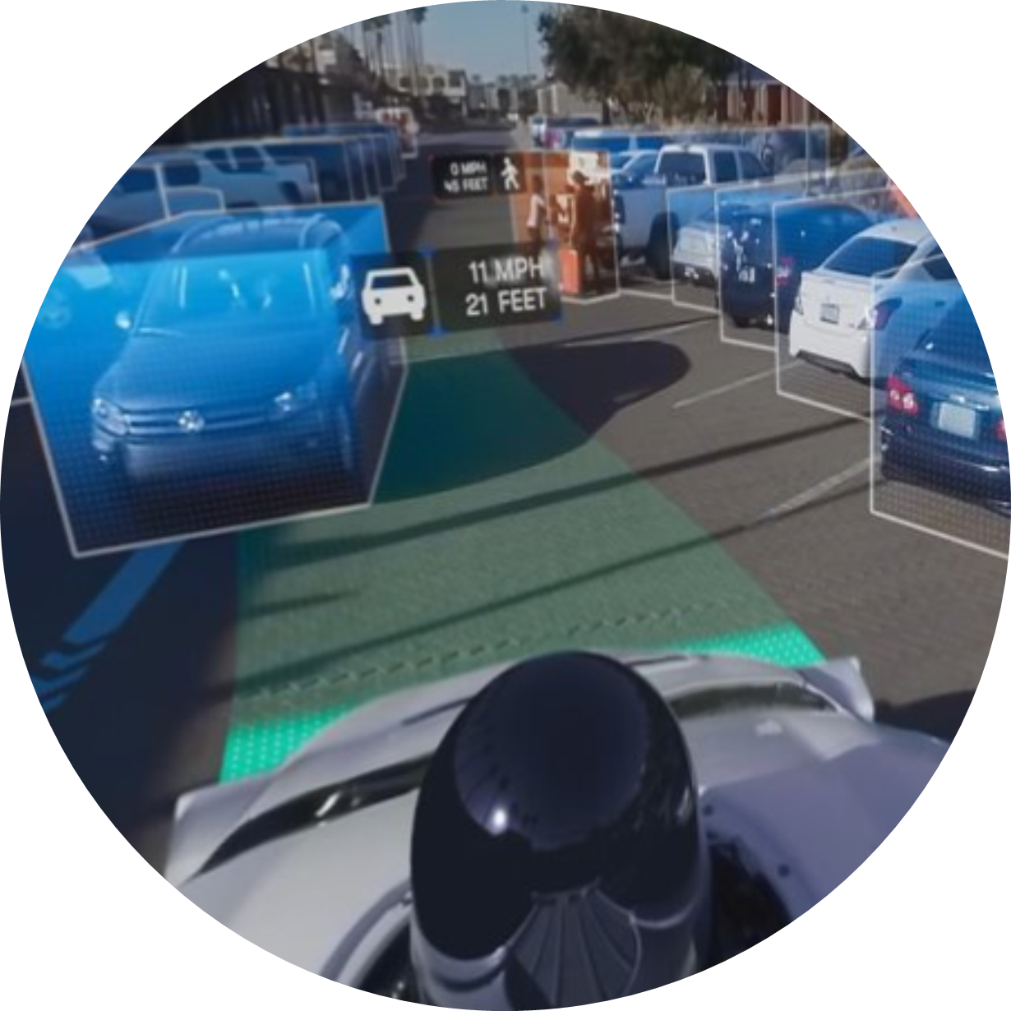




























Perceptrons: The First Trainable Neural Networks
Christopher, Harvey, Sean, Nathan
Target Audience: Sixth Form Computer Science Students
Introduction –
From Biological to Artificial
– Humble Beginnings
The Single Layer Perceptron
Biological brains contain billions of individual neurons which can send signals between each other.
1
$$x_{0}$$
$$x_{1}$$
$$x_{2}$$
At the heart of bringing simulated biological neurons to life was the perceptron: a computerised model based on the brain that has the ability to learn.
The axons of an input neuron release neurotransmitter chemicals that are received by the dendrite.
1
1
2
$$w_{0}$$
2
$$w_{2}$$
$$w_{1}$$
1
The perceptron mimics a single biological neuron, receiving inputs ($x_{i}$) that represent other neuron’s excitement levels.
2
Upon receiving a signal, depending on the type of connection, gates in the cell wall, allowing the flow of ions. A positive change in charge is excitatory, while a negative change is inhibitory.
3
$$b$$
2
The strength of each input connection is represented by a weight ($w_{i}$), where positive values are excitatory, and negative values are inhibitory.
4
3
Each input is multiplied by its weight, and the results are summed to determine the perceptron’s activation state. A bias ($b$) is added, acting as an activation threshold.
3
Once enough charge has accumulated, the cell fires, sending an electrical current down the neuron which triggers its axons to release neurotransmitters.
4
The final activation value is passed through an activation function ($σ\left(x\right)$) which is a mathematical rule that decides whether a neuron should “fire” or not.
$$y=σ\left(\left[\sum_{i}{x_{i}w_{i}}\right]+b\right)$$
If computers could artificially simulate biological neurons and the information represented by their connections, then maybe computers could learn to replicate human intelligence as well.
Typically, the activation function is non-linear to allow the neuron to represent more complex patterns.
1943 McCulloch and Pitts: Artificial Neurons
3
1957 Frank Rosenblatt: The Perceptron Model
SEE THIS POSTER COME TO LIFE IN AR
$$y$$
v
Endless Possibilities –
Deep Machine Learning
– Learning from Mistakes
Gradient Descent & Backpropagation
$$x_{1}$$
$$x_{2}$$
The perceptron model learns by adjusting weights based on errors until it reaches an acceptable threshold — a process called backpropagation.
$$w_{1}$$
$$w_{2}$$
1
Compute the error ($E)$ by determining how far the output ($y$) is from the actual target value ($Y$).
$$E={\left(Y−y\right)}^{2}$$
2
Determine how much each weight or bias should be adjusted to reduce the error and move the output closer to the target.
$$y^{′}$$
$$\frac{dE}{dw_{i}}=2\left(Y−y\right)∙σ^{′}\left(y^{′}\right)∙w_{i}$$
$$\frac{dE}{db}=2\left(Y−y\right)∙σ^{′}\left(y^{′}\right)$$
$$b$$
$$y$$
3
Repeatedly adjust the weights and biases over many iterations to gradually reduce the model’s error.
This iterative process is known as Stochastic Gradient Descent.

Slide 2
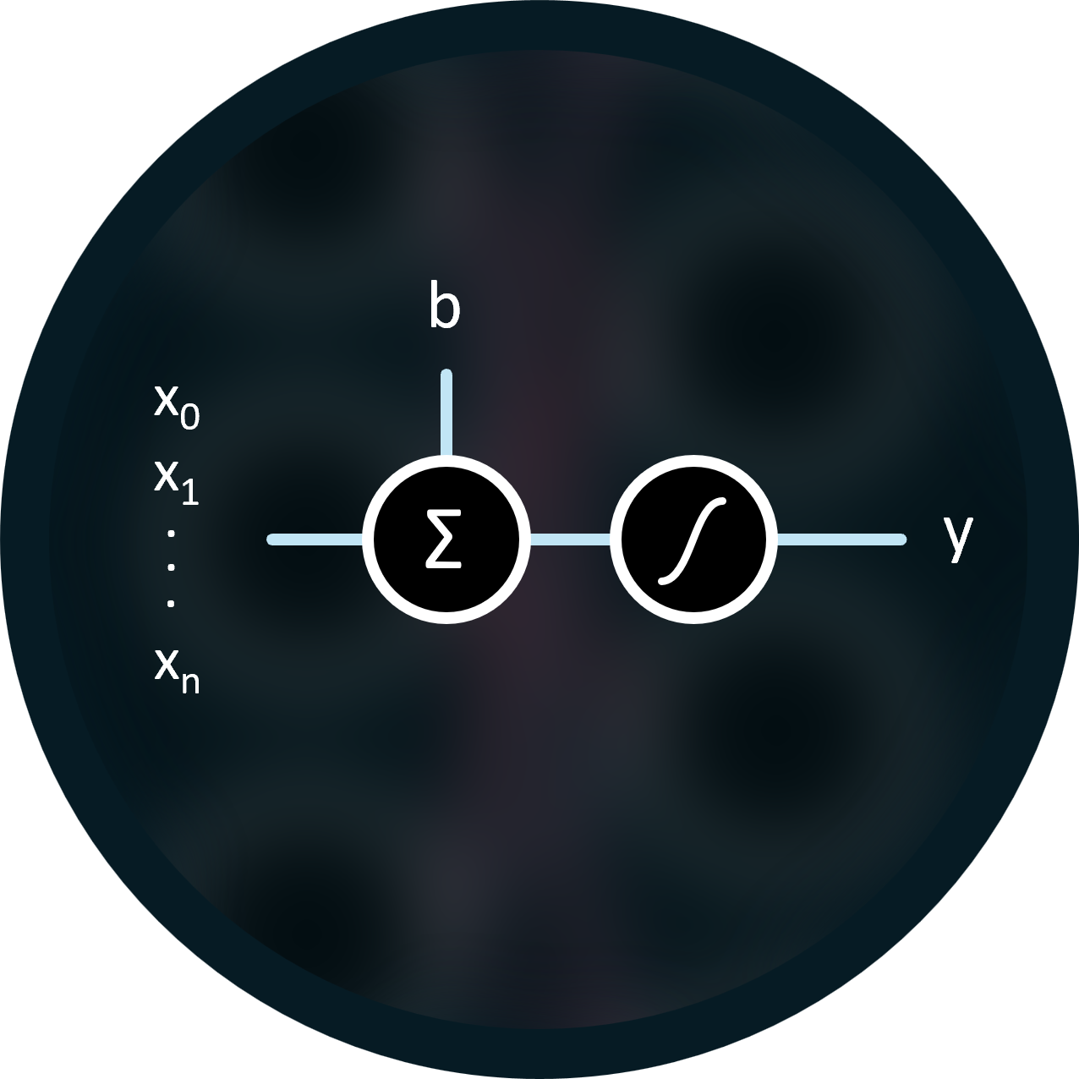



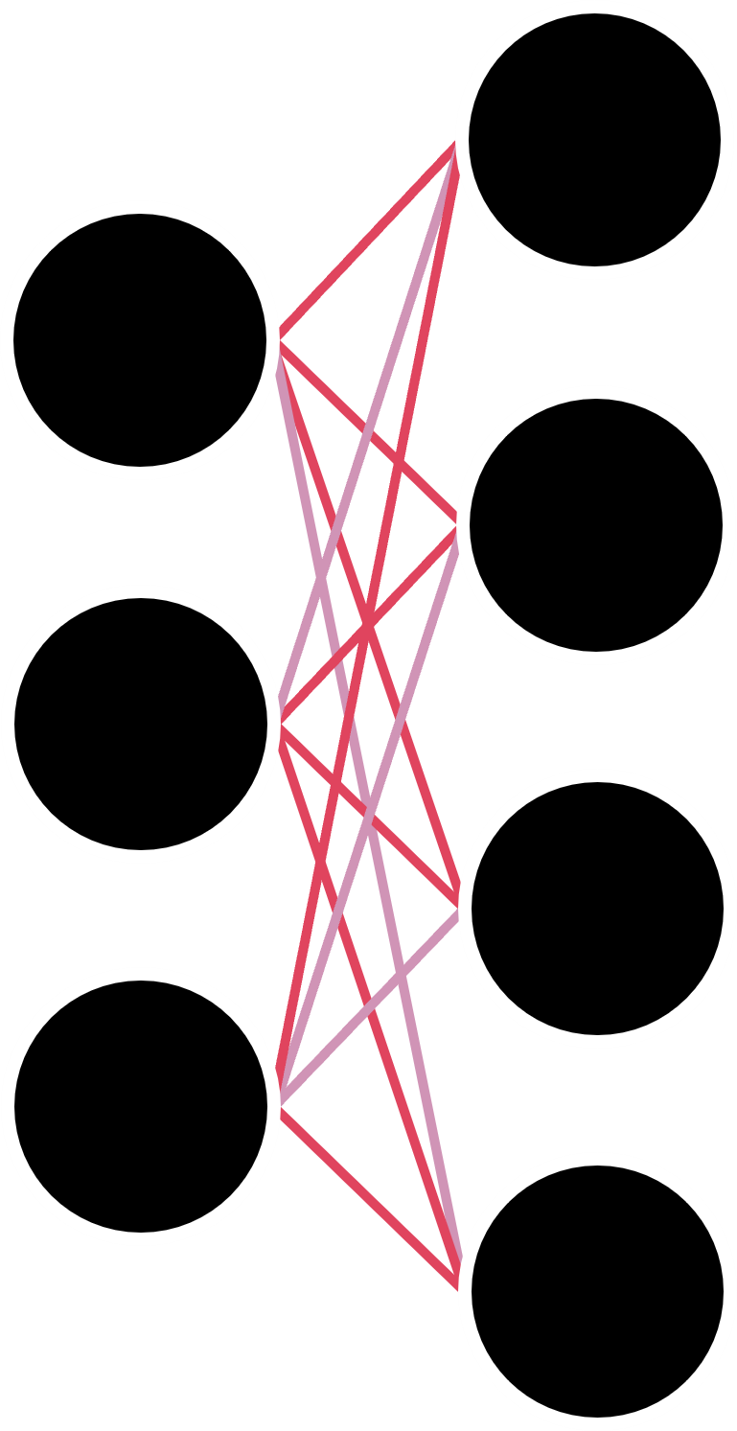





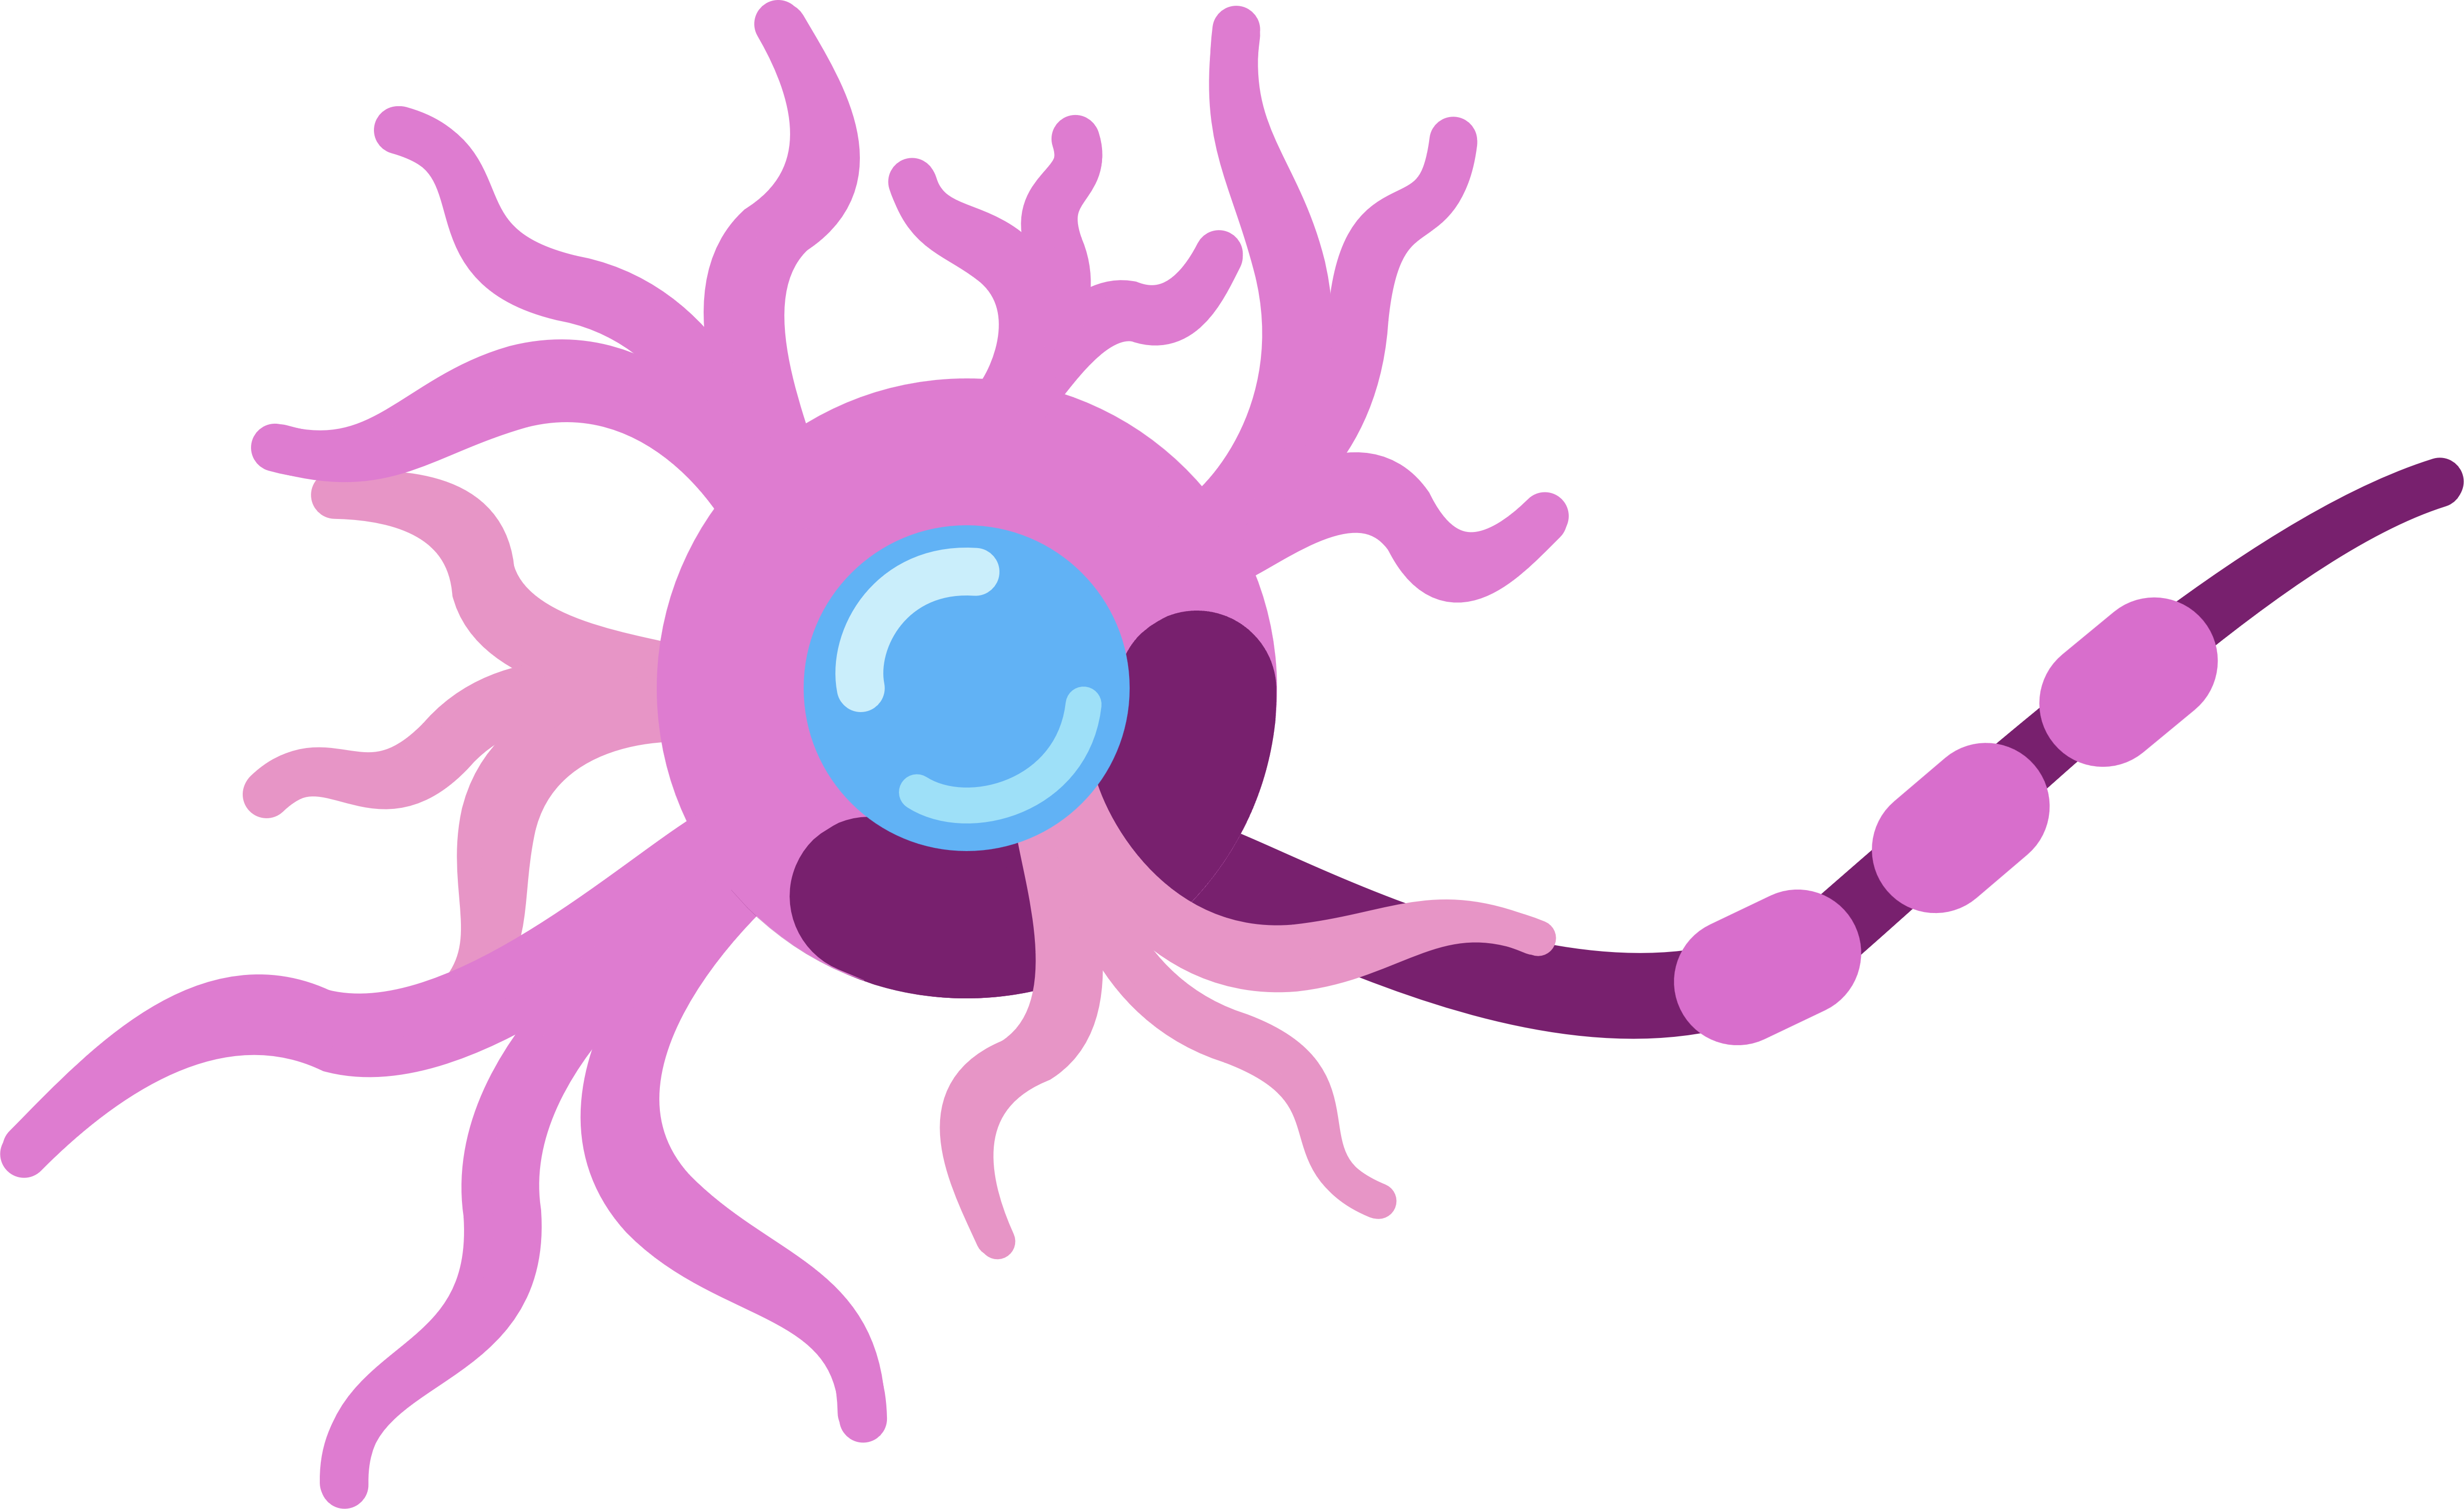


Biological brains contain billions of individual neurons which share inhibitory and excitatory connections with each other. An inhibitory connection reduces a neuron's likelihood of activation, while an excitatory connection increases it. When a neuron is sufficiently excited, it will fire an activation signal which propagates through said connections. It should be noted that every neuron has its own activation threshold.
x₀
b
x₁
.
Σ
y
.
.
x_{n}
x₀
b
x₁
.
Σ
y
.
w₀ … w_{n}
.
x_{n}

Slide 4
ウ
の
ね
ぬ
ひ
を
え
ん
ヱ
ヤ
ツ
セ
あ
き
チ
タ
な
ろ
ネ
サ

Slide 5







$$x_{1}$$
$$x_{2}$$
$$w_{1}$$
$$w_{2}$$
$$y^{′}$$
$$b$$
$$y$$

